Slide 1
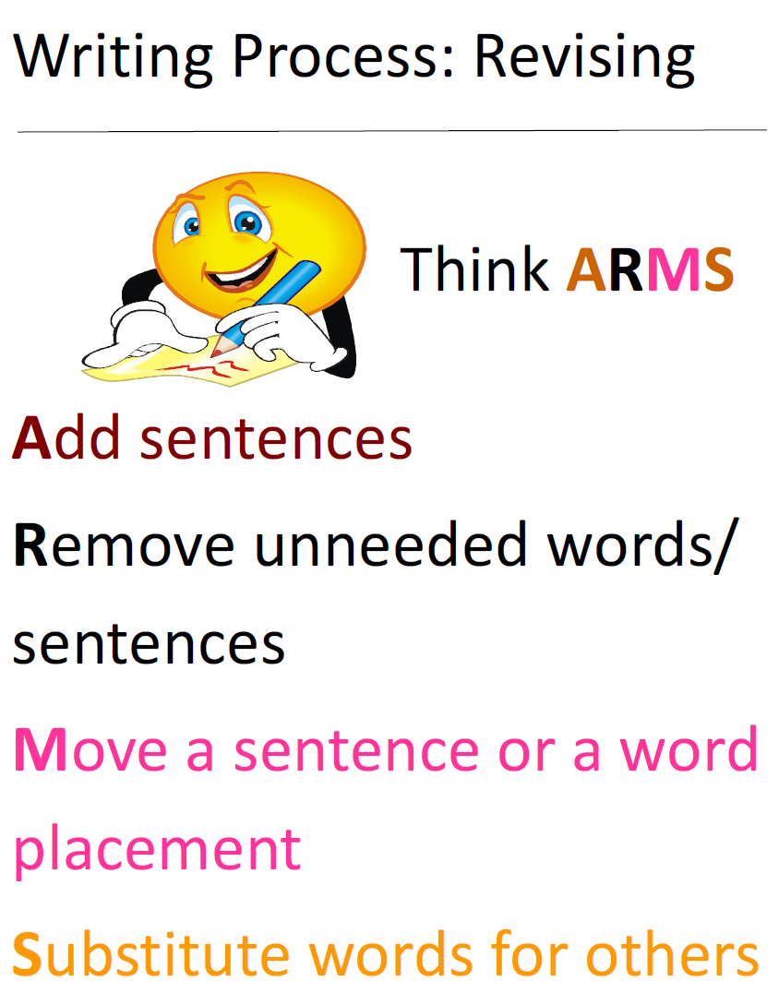
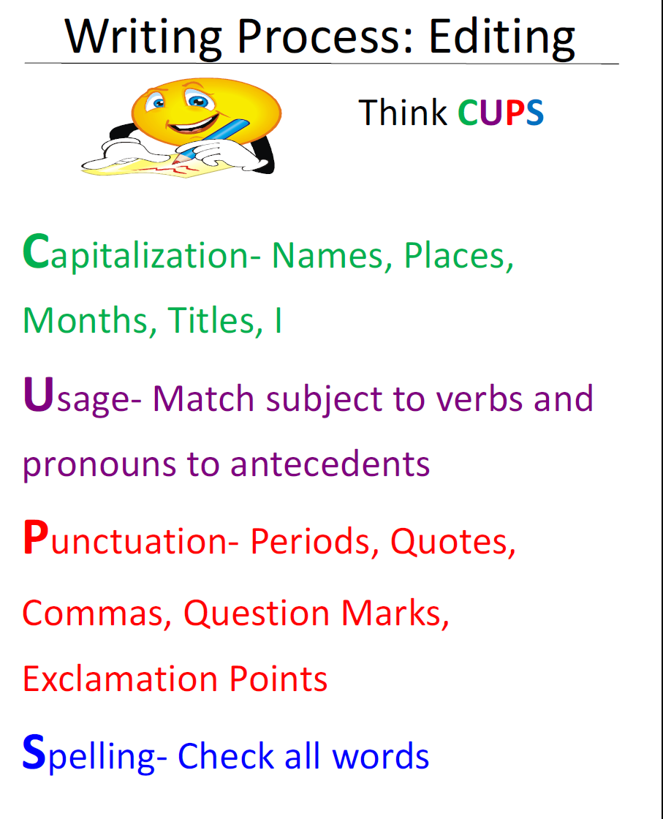

Slide 2


Writing Process: Revising
Writing Process: Editing
Think ARMS
Add sentences
Remove unneeded words/sentences
Move a sentence or a word placement
Substitute words for others
Think CUPS
Capitalization- Names, Places, Months, Titles, I
Usage- Match subject to verbs and pronouns to antecedents
Punctuation- Periods, Quotes,
Commas, Question Marks,
Exclamation Points
Spelling- Check all words

